Slide 1
CONSULTING FOR CHEAPSEATS AIRLINE
Gaurav Salvi
Shuying Zhao
Purva Kedari
Nikhil Patil
Yue Wang

Slide 2
Overview
The project is aimed at analyzing the data from the dataset of customers flying in the United States and to generate actionable insights by analyzing customers with low satisfaction.
The aim of the project is to analyze the reasons for customers with low satisfaction and suggest recommendations to the client airways to increase their customer satisfaction.

Slide 3
APPROACH
Formulate Business Questions
Import the dataset
Select one client and clean the dataset.
Carry out Descriptive Analysis
Providing suggestions and recommendations to the client.
Conducting SVM to corroborate the results.
Create Visualizations and modelling to analyze the dataset.

Slide 4
BUSINESS QUESTIONS
Predict customers with low satisfaction
Analyze the attributes/factors that affect customer satisfaction
Analyze what causes customers to give high satisfaction
Analyze what causes customers to give low satisfaction
Recommendations and suggestions to the client airways to improve customers with low satisfaction

Slide 5
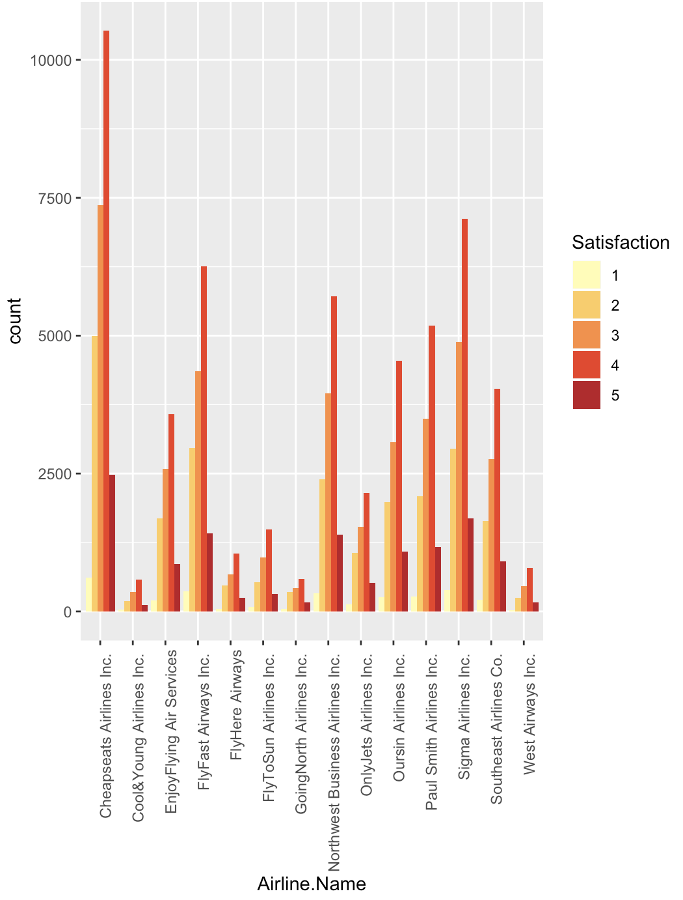
Satisfaction of all airlines
DATA AFTER CLEANING:
Total Observations: 129,886
Cheapseats Observations:26,058(~20%)
Observations from other Airlines:103,828 (~80%)
Cheapseats Airline customers has the higher proportion and large amount of low satisfaction.

Slide 6
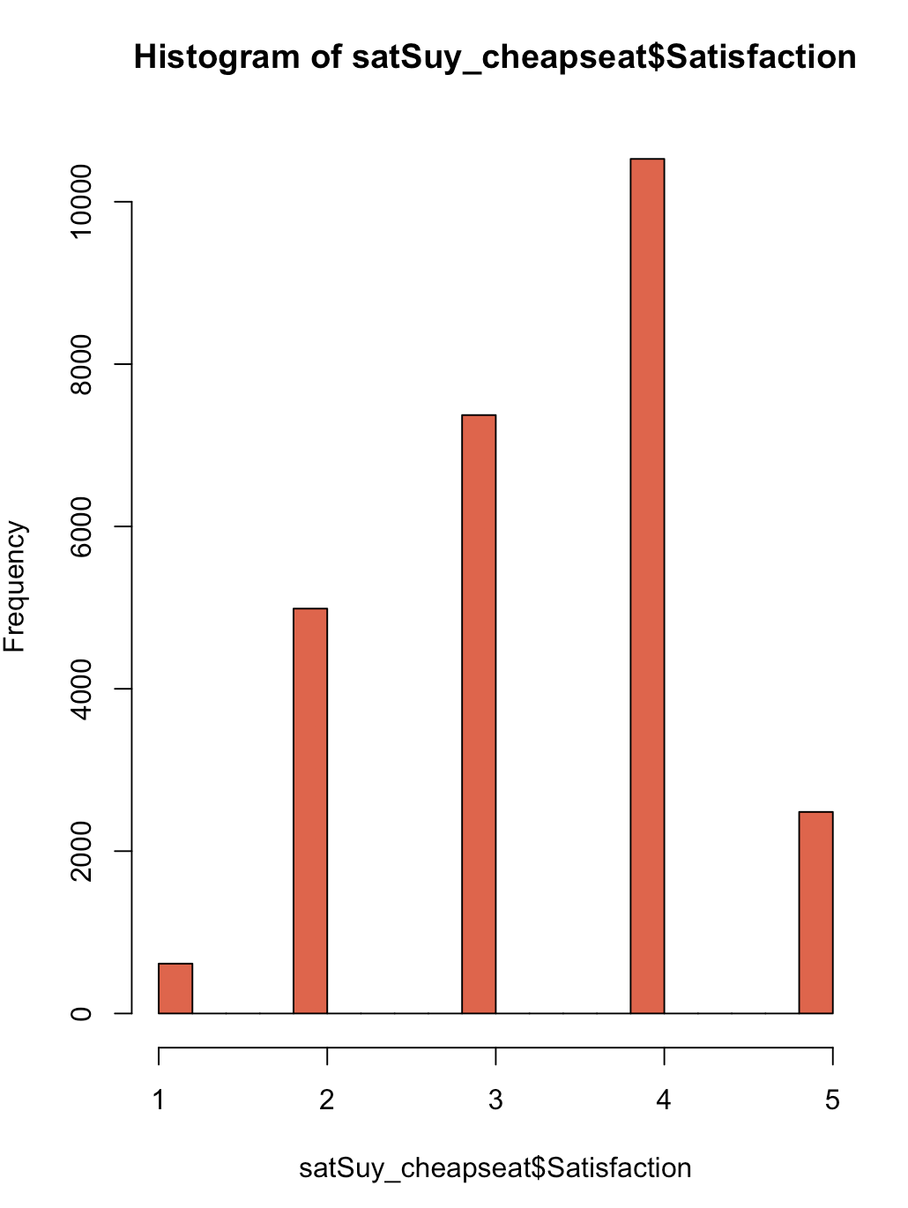
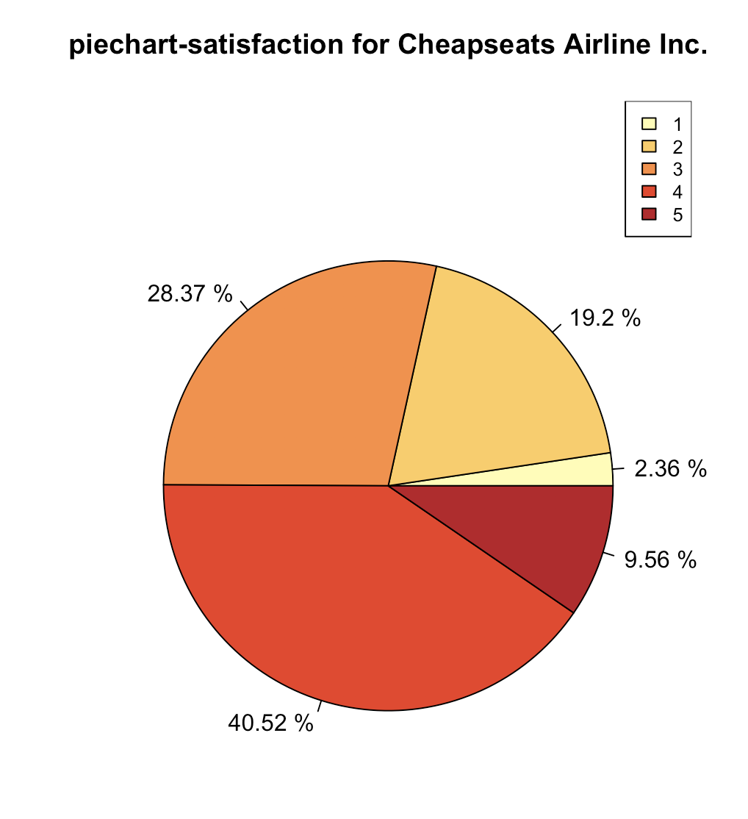
Satisfaction of Cheapseats Airline Inc.
Nearly 50% of the Cheapseats Airline customers have the low satisfaction(less than 4).

Slide 7
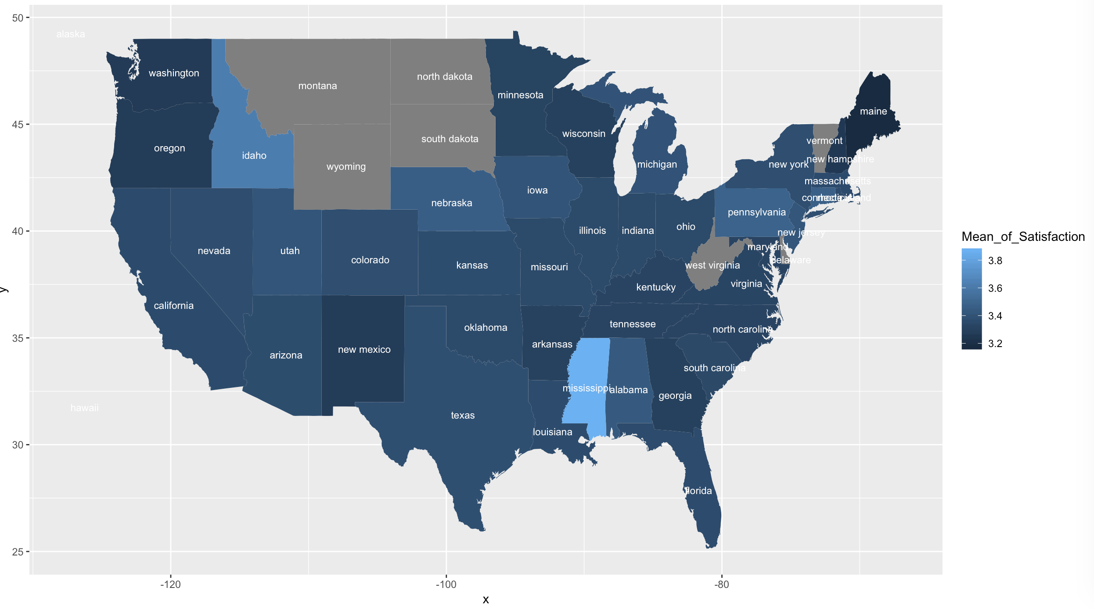
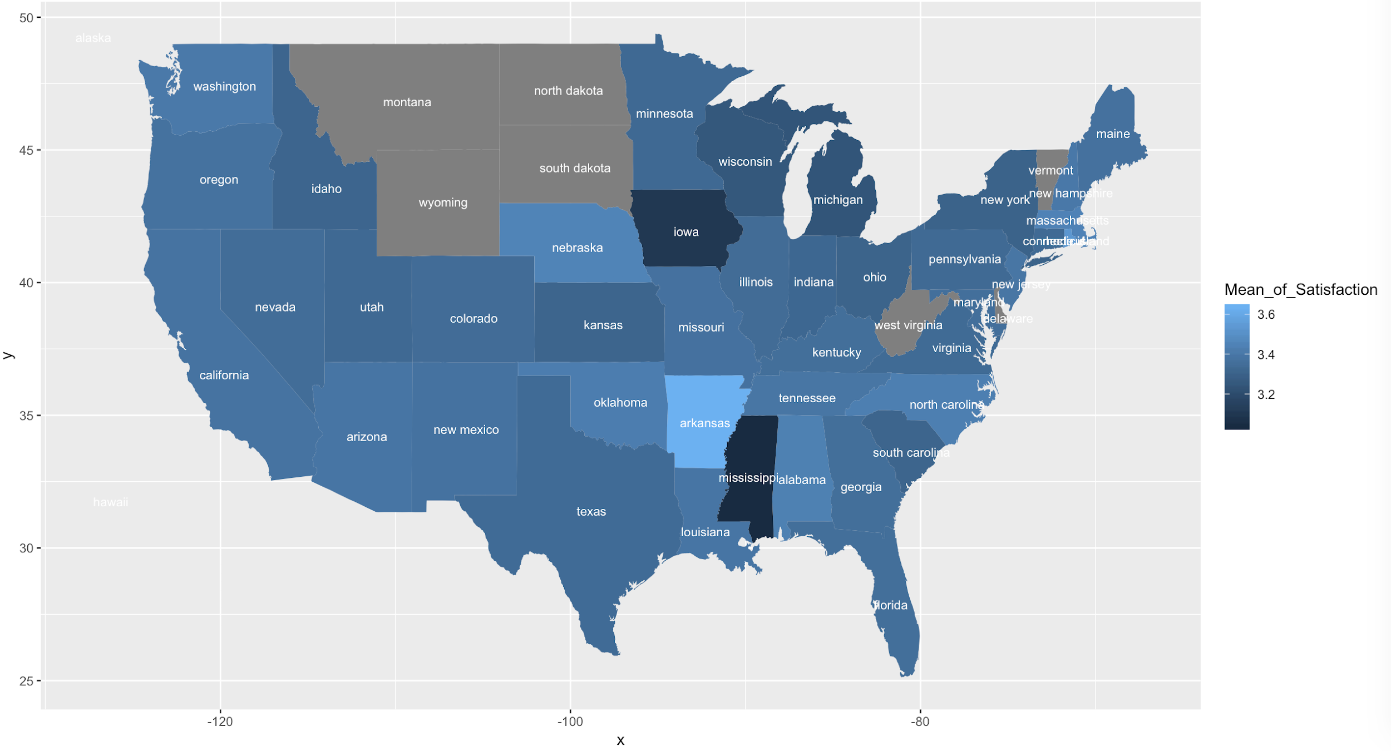
Mean Satisfaction Across Destination States
Destination States with low satisfaction are :
Washington
Oregon
Maine
New Mexico
Origin States with low satisfaction are:
Mississippi
Iowa
Mean Satisfaction Across Origin States

Slide 8
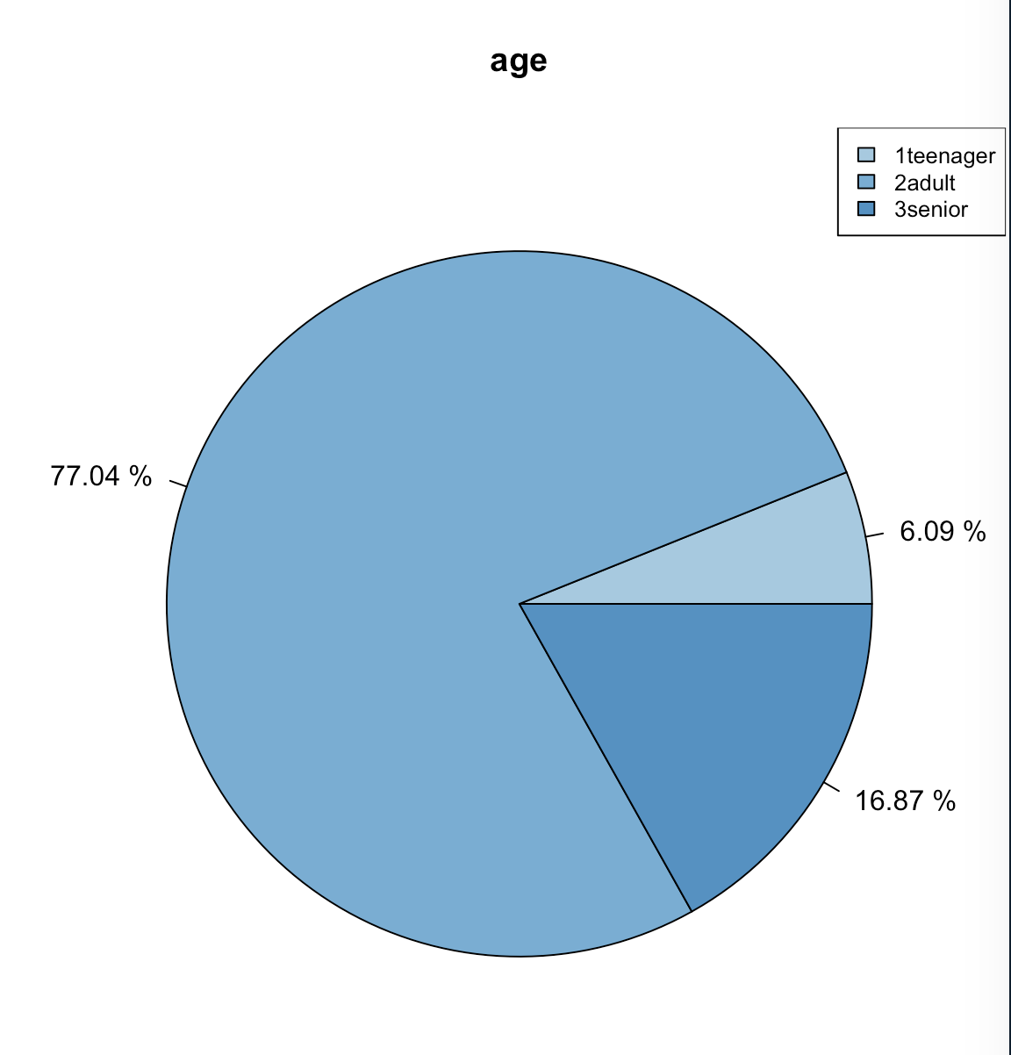
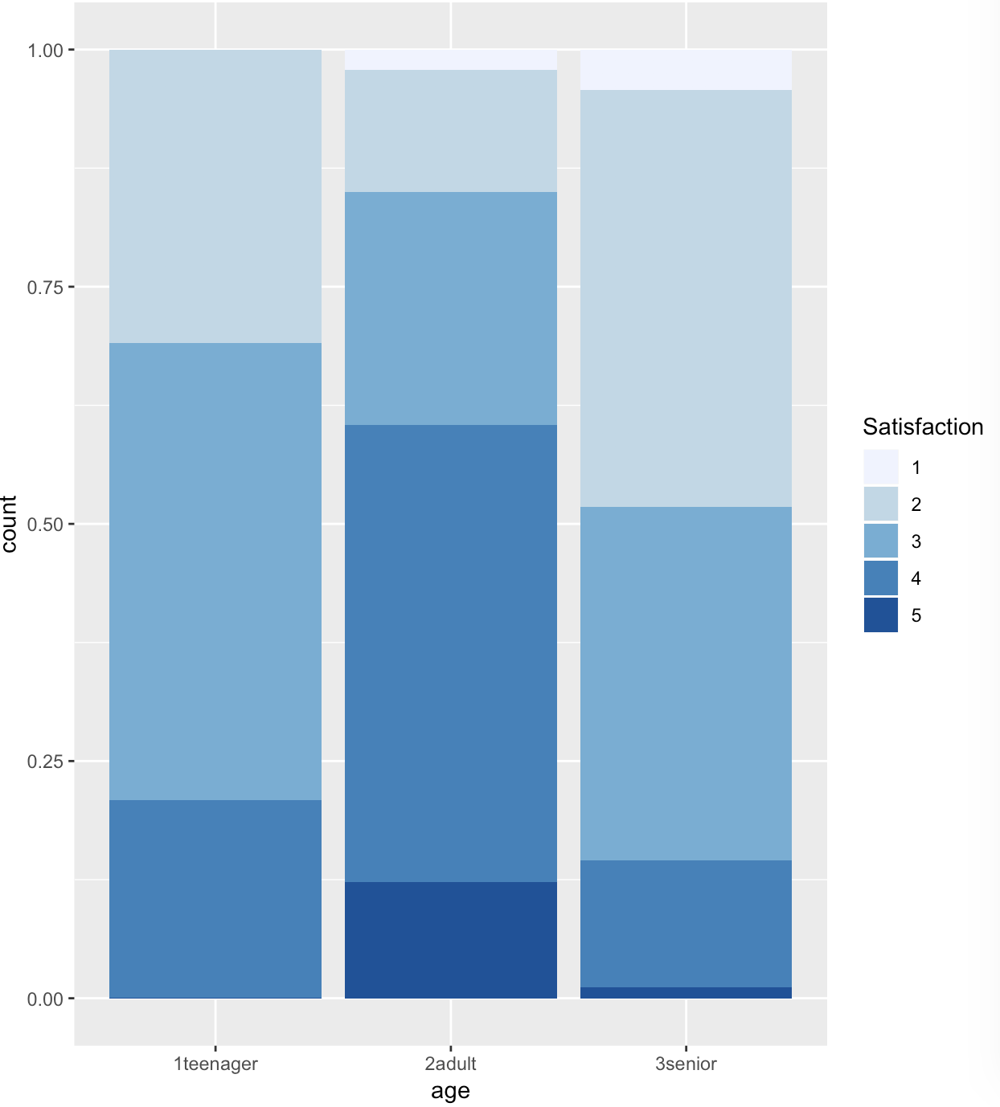
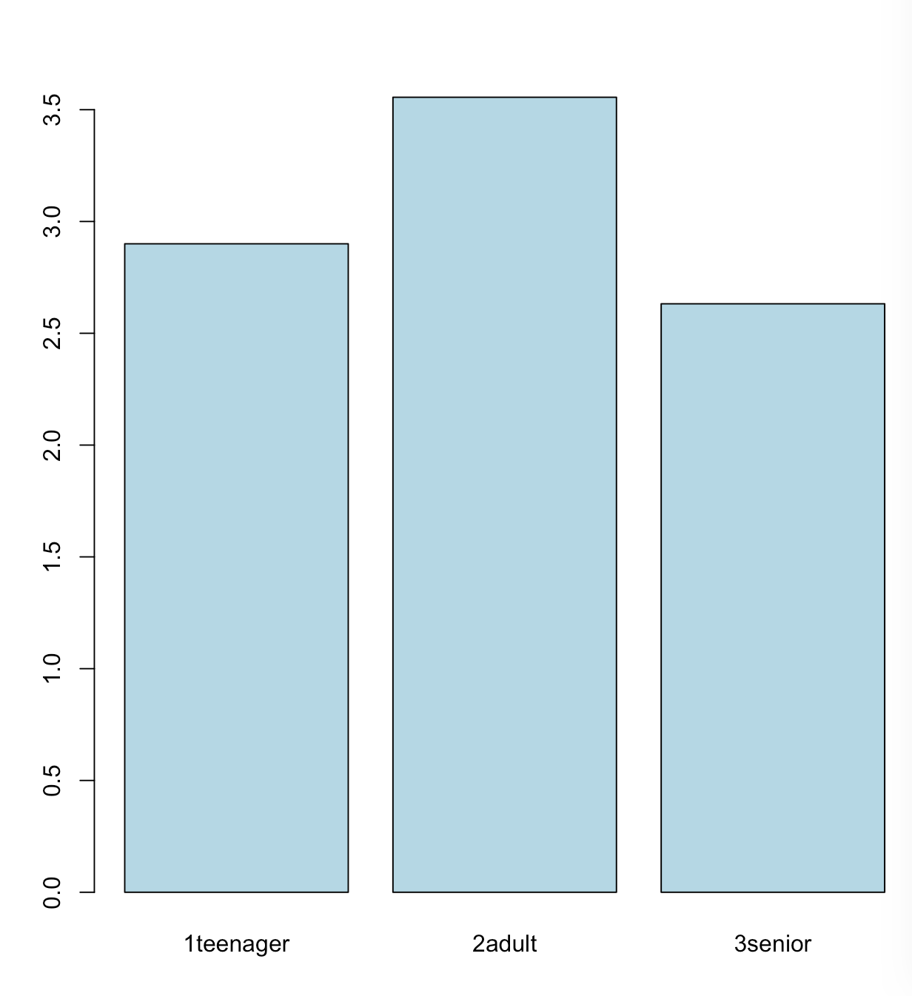
Cheapseats Airline Customers’ Age
Proportion of satisfaction
Average Satisfaction
Seniors have the lowest satisfaction while adults have the highest satisfaction.

Slide 9
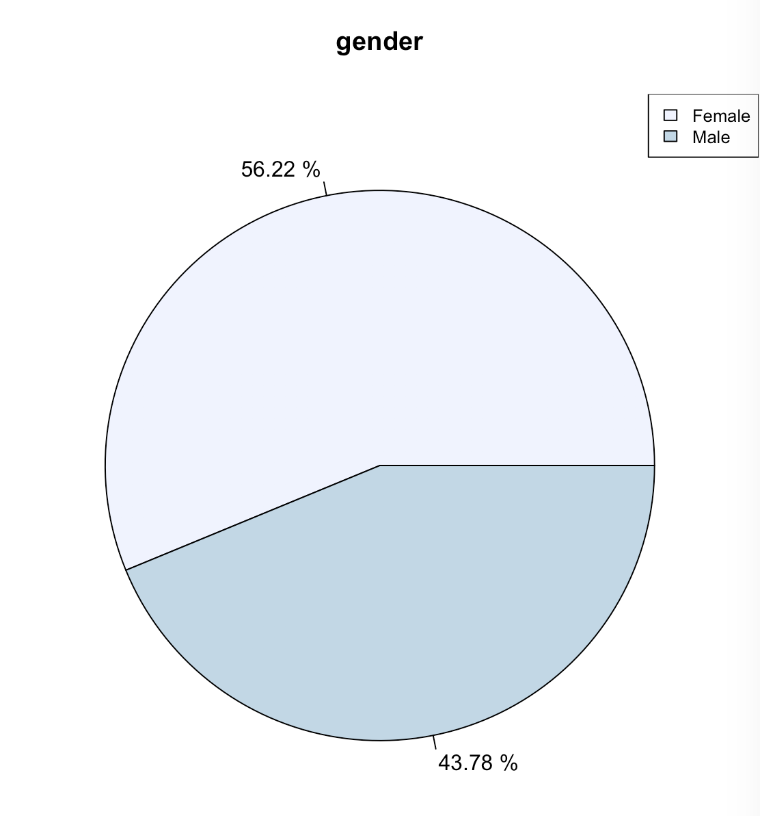
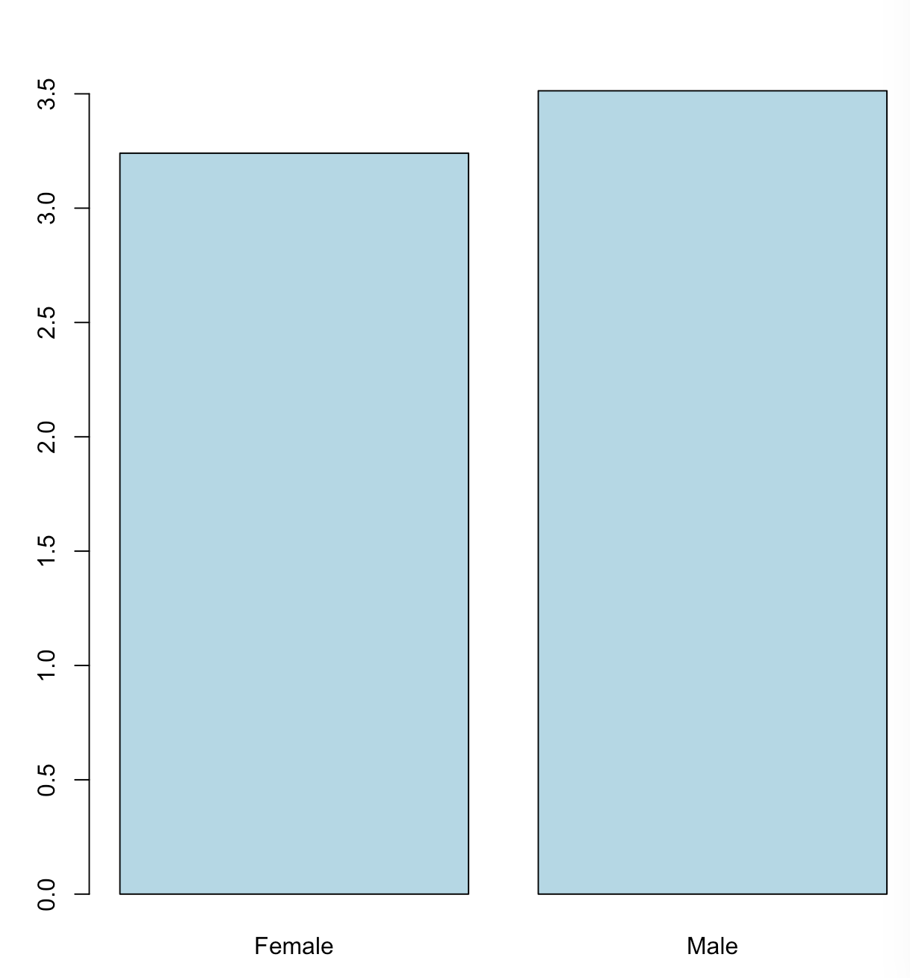
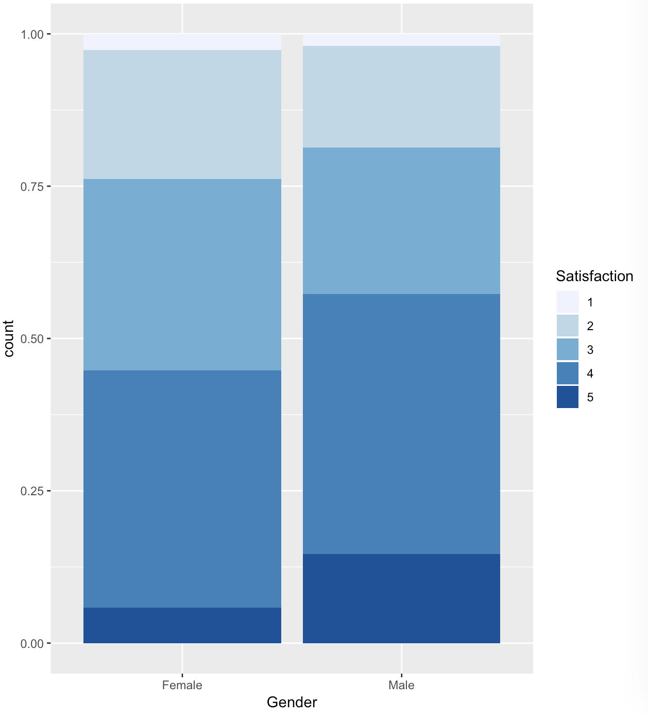
Cheapseats Airline Customers’ Gender
Proportion of satisfaction rate
Average Satisfaction
Over 55% of our customers are female
Male travelers show higher satisfaction while female travelers show low satisfaction.

Slide 10
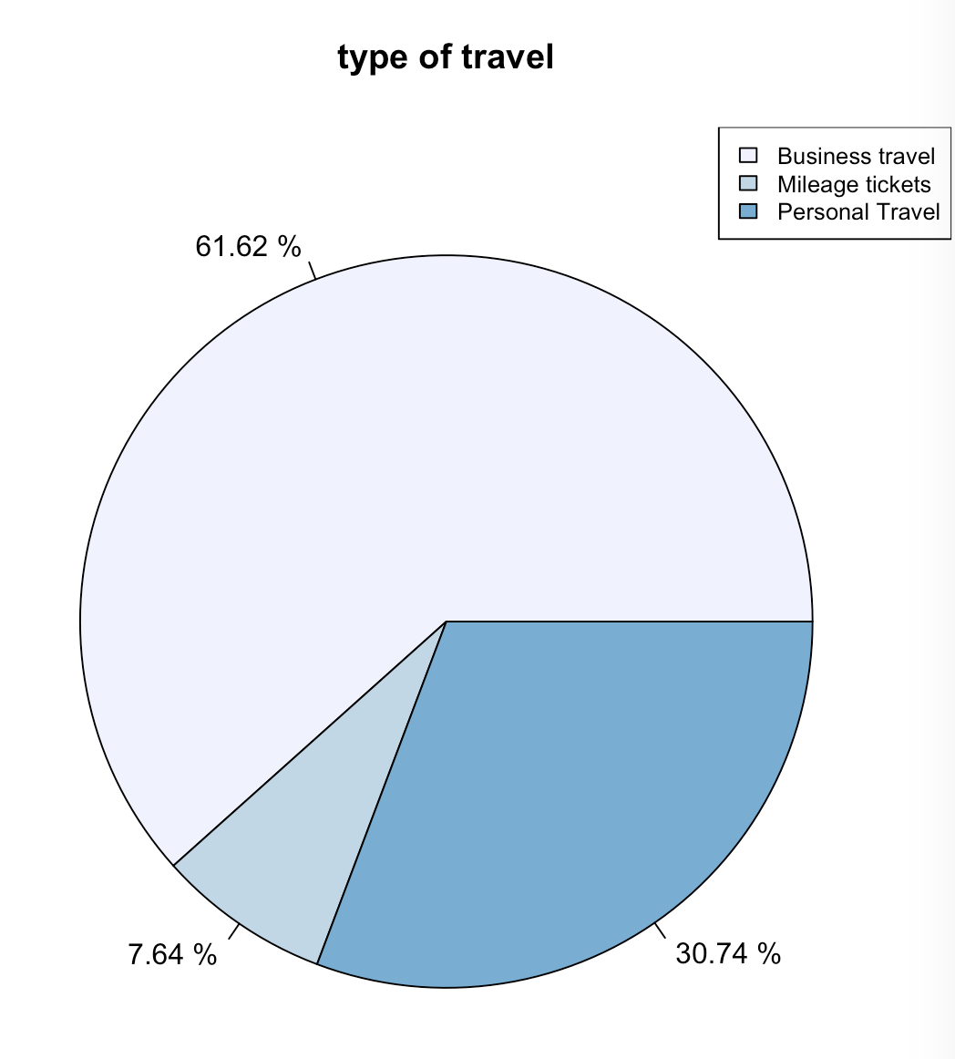
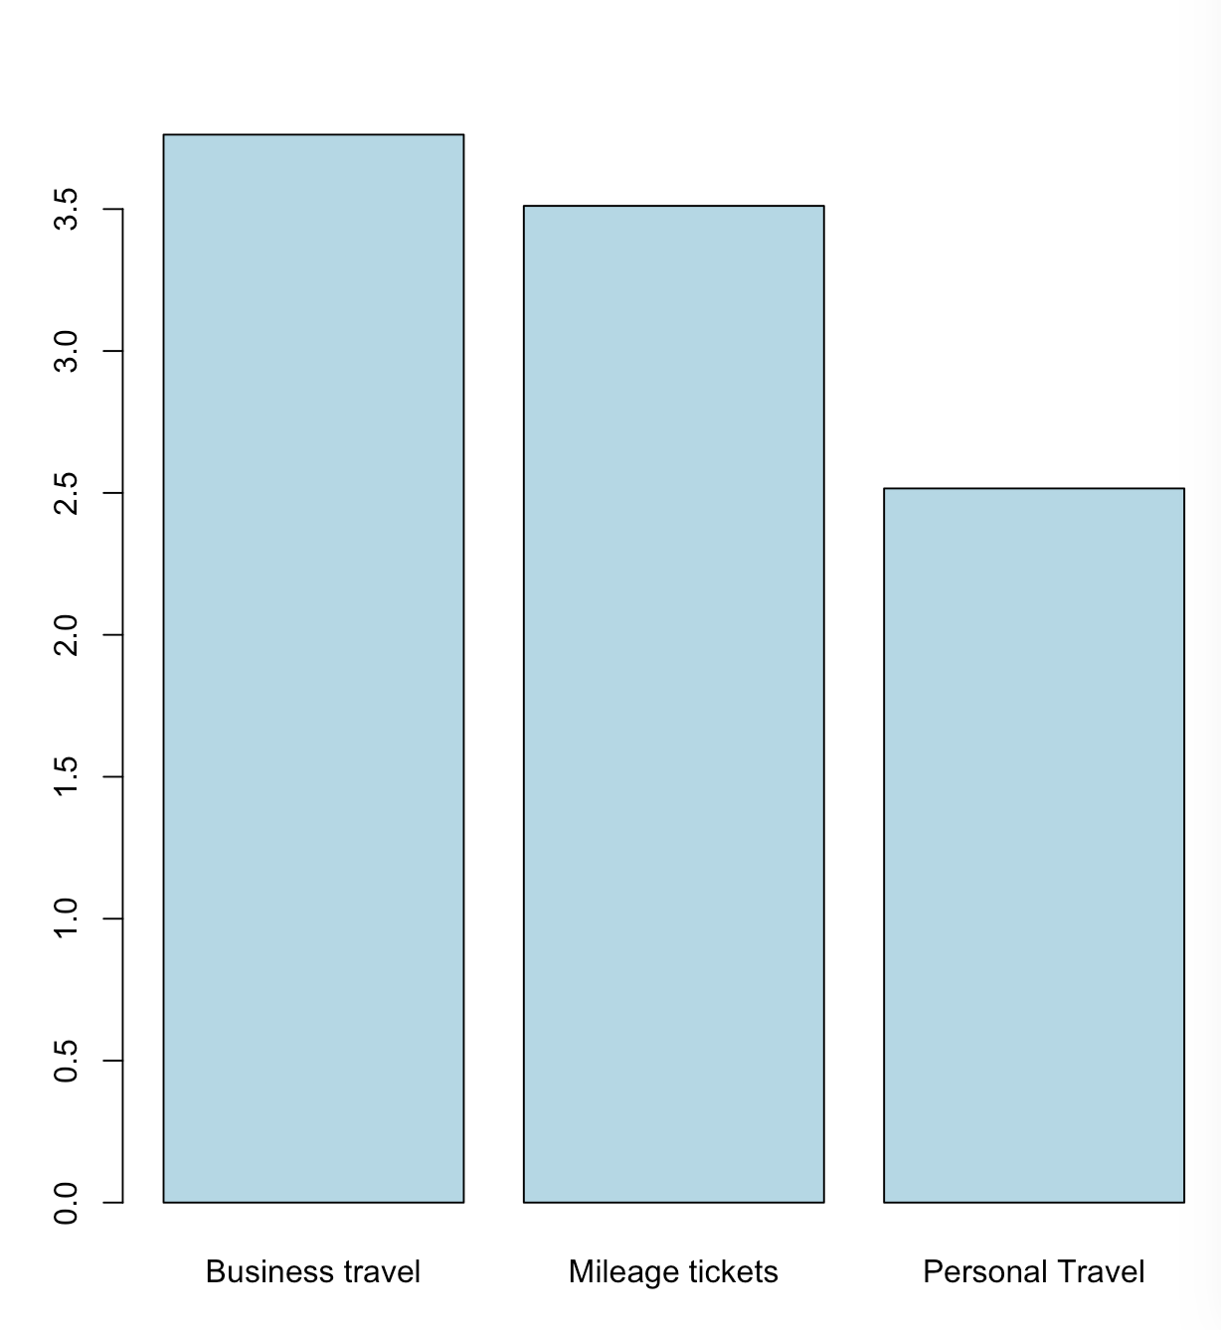
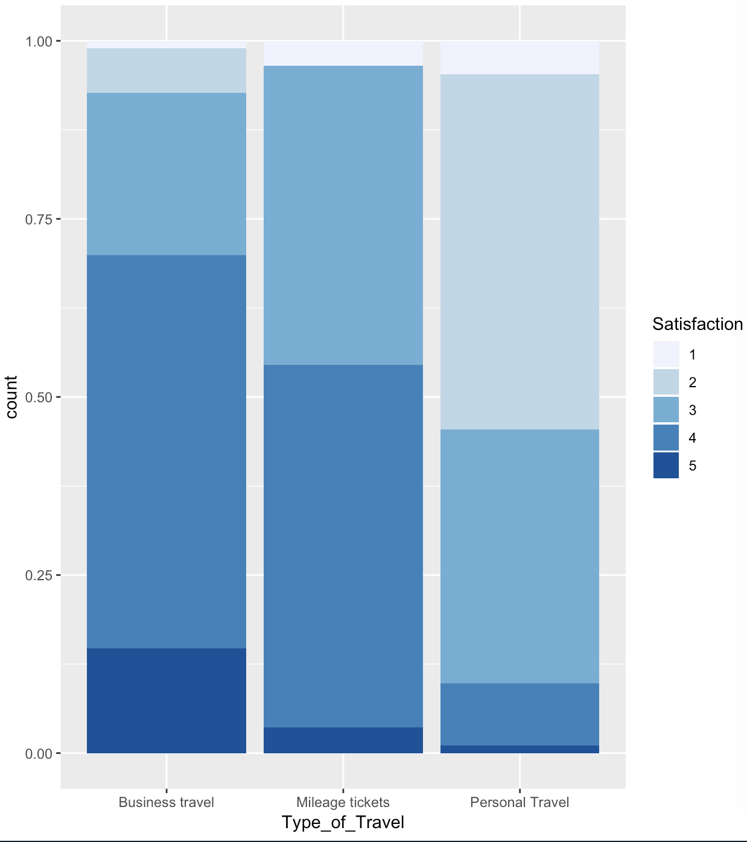
Cheapseats Airline Customers’ Travel Type
Proportion of satisfaction rate
Average Satisfaction
Over 60% of our customers are business travelers while 30% of them are personal travelers
Business travelers show higher satisfaction while personal travelers show lower satisfaction.

Slide 11
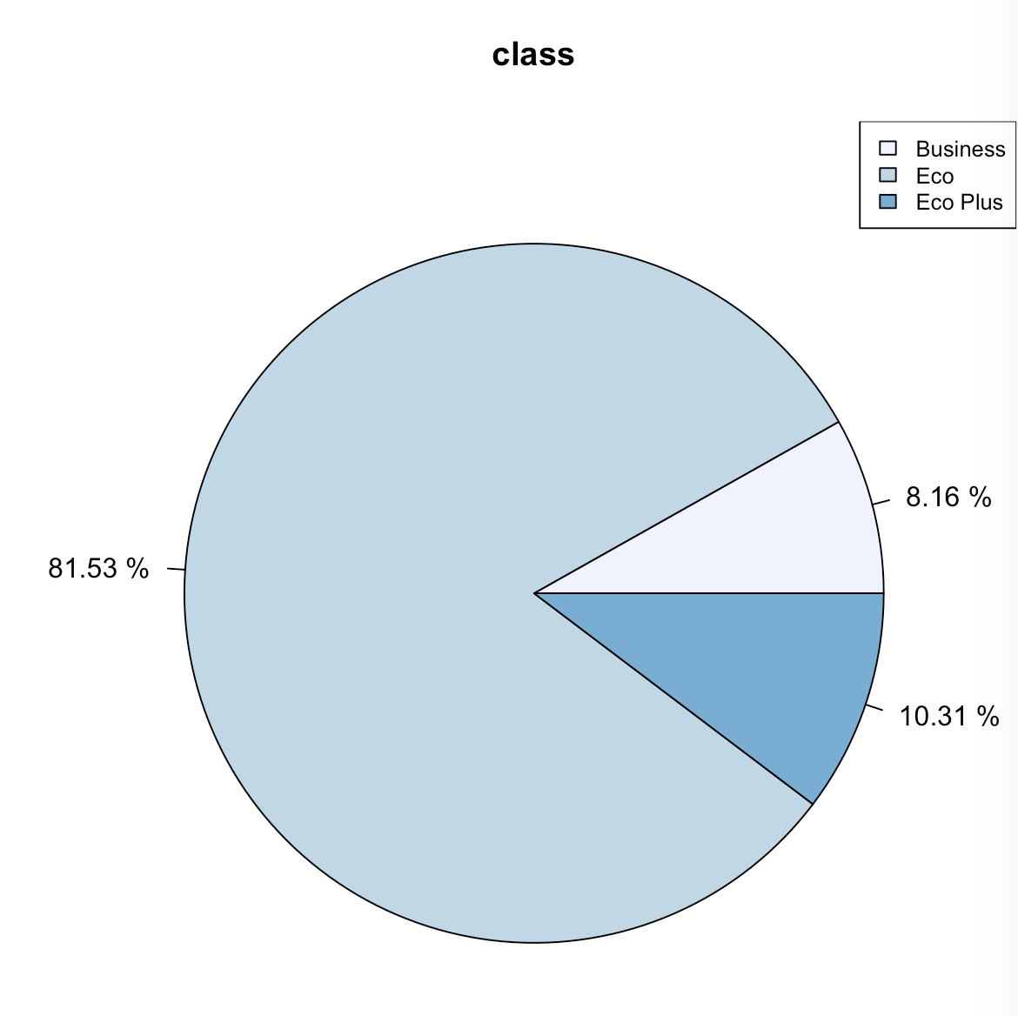
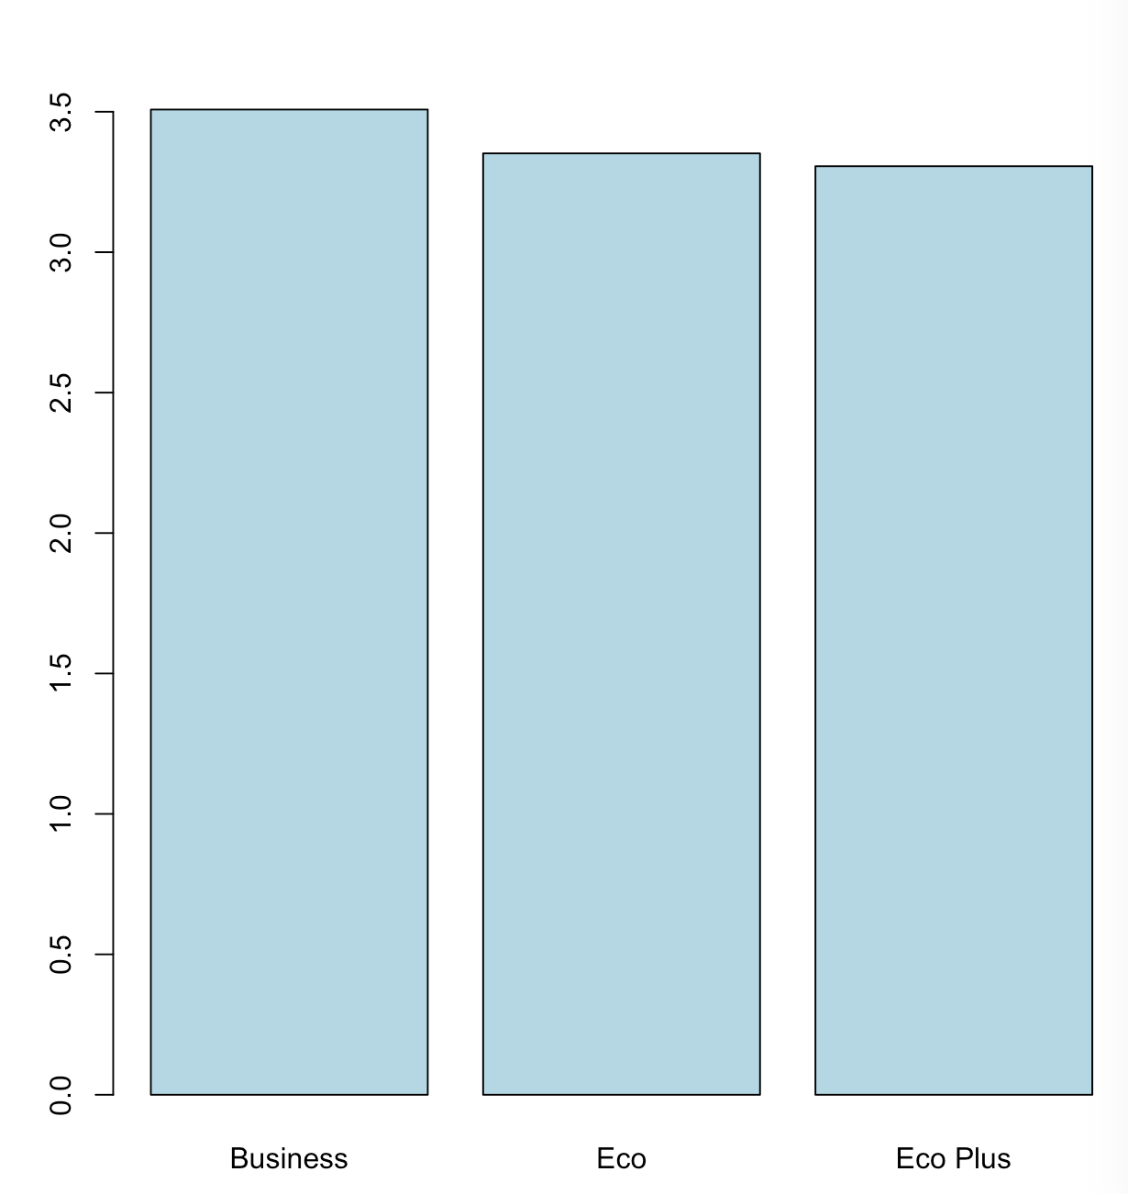
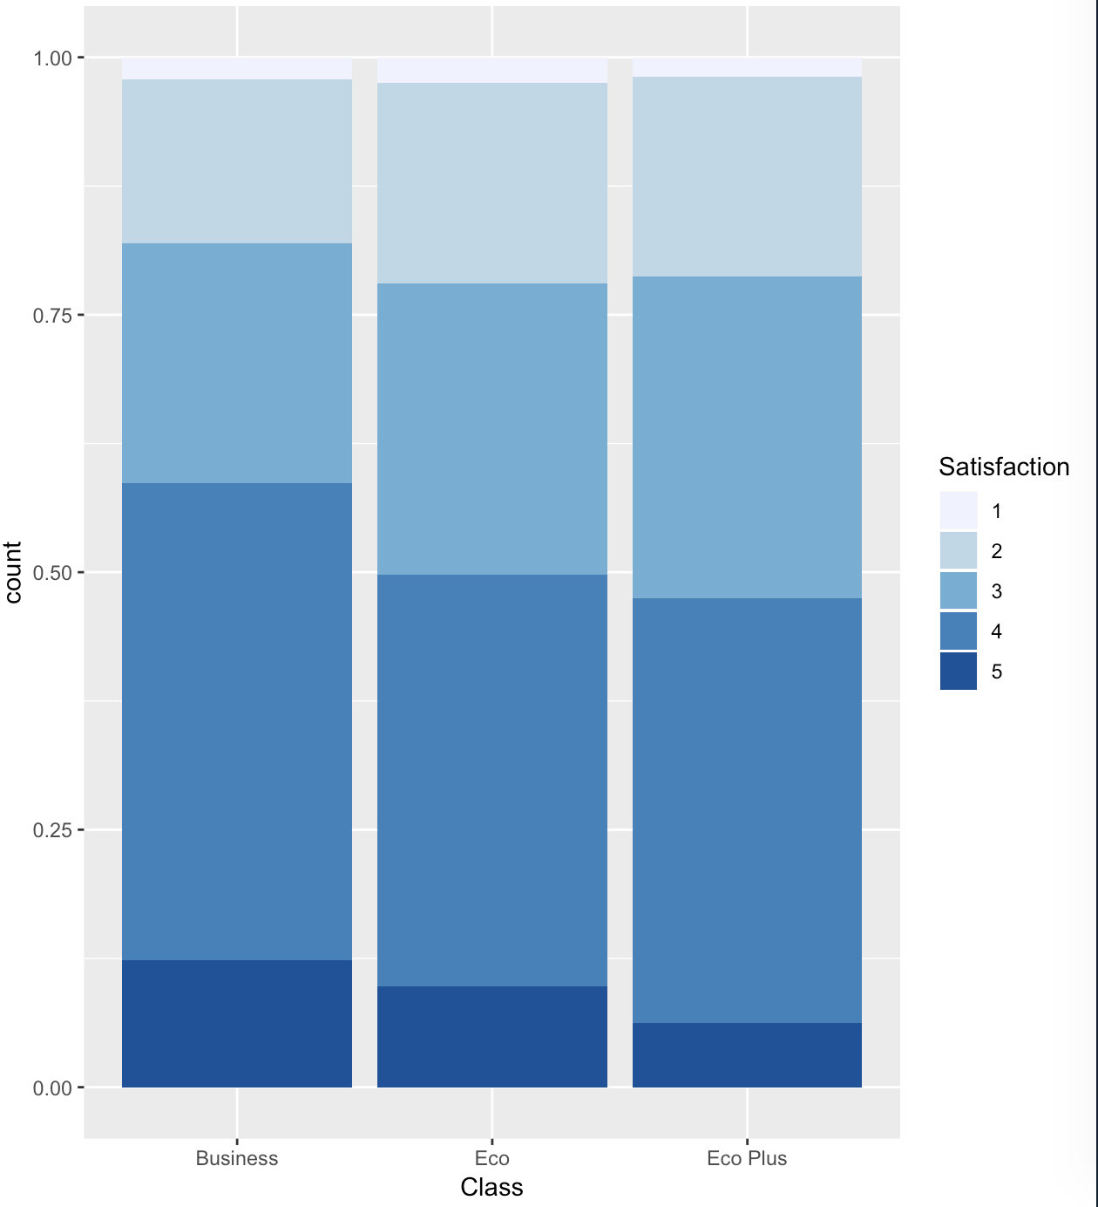
Customers’ Ticket Class
Average Satisfaction
Proportion of satisfaction rate
81.63% of our customers are from economy class.
Customers in business class give higher score of satisfaction while customers in economy class give lower score of satisfaction.

Slide 12
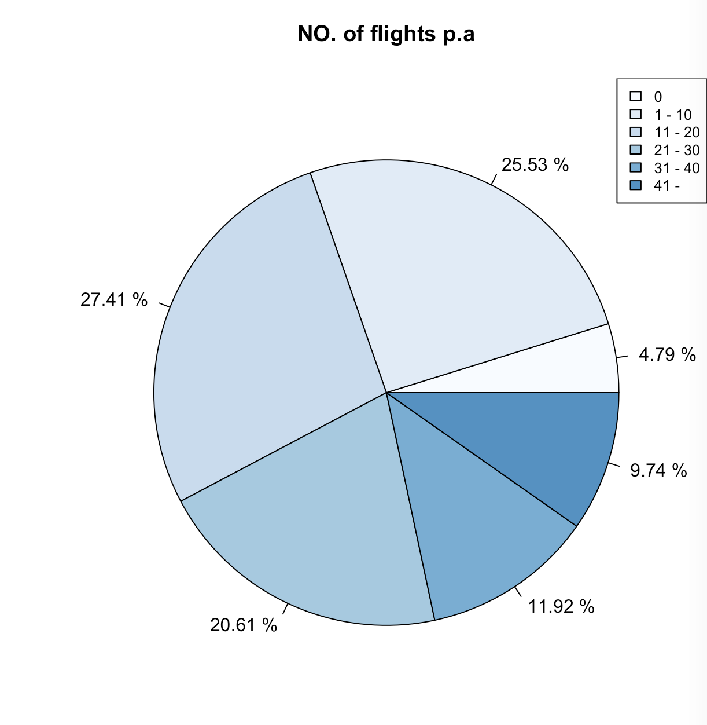
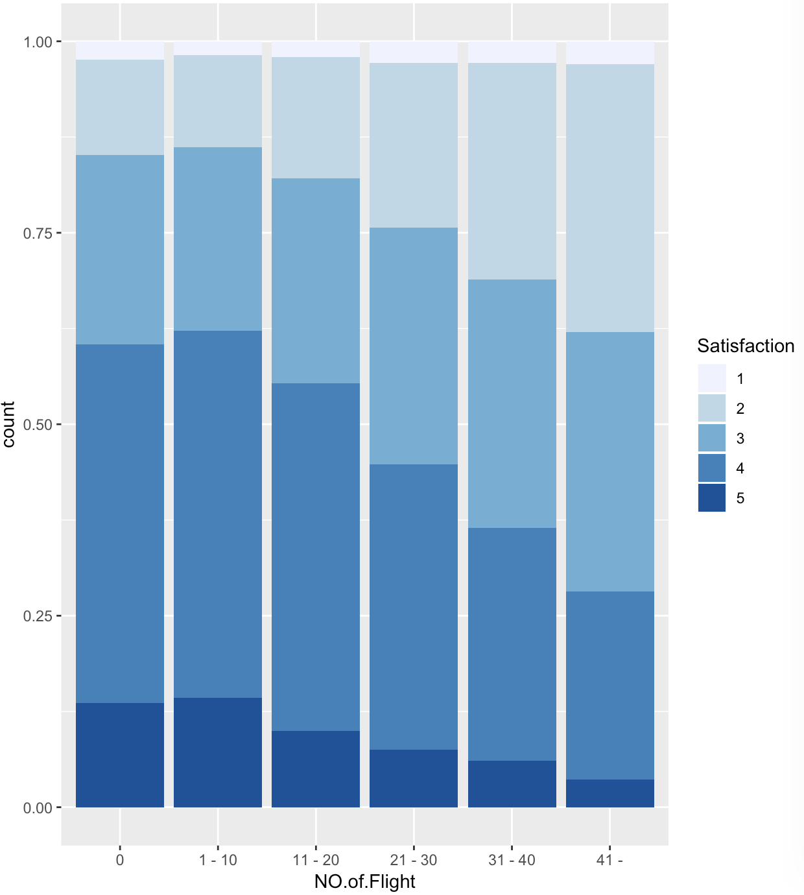
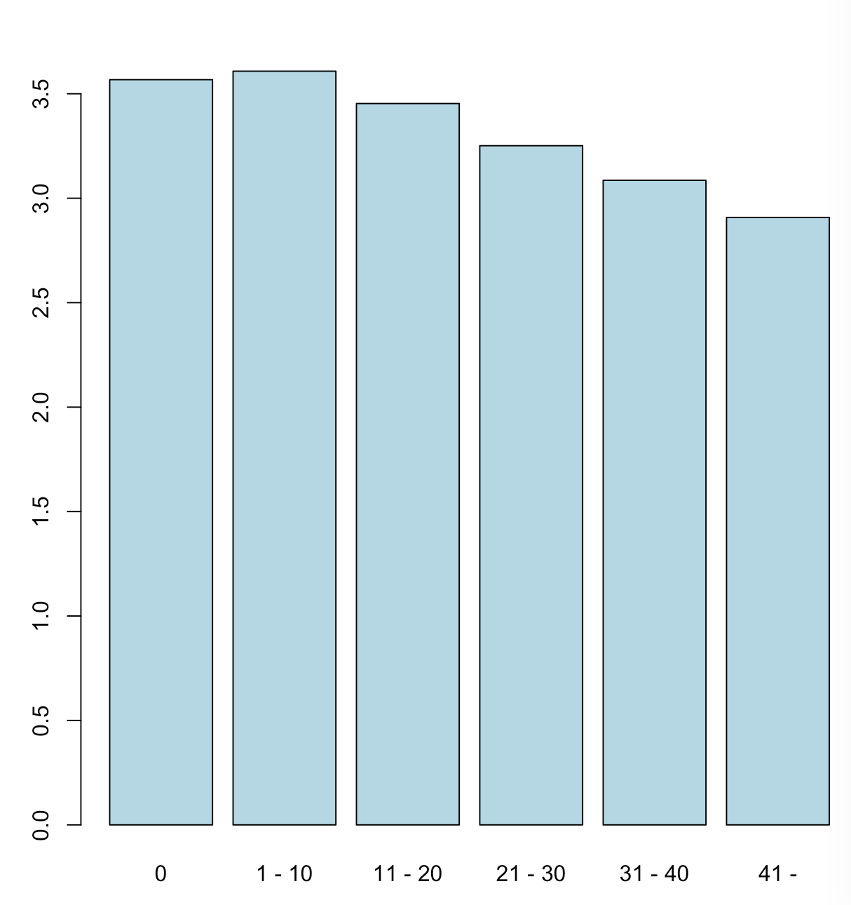
Number of flights per year
Proportion of satisfaction
Average satisfaction
People take more flights would give lower score of satisfaction.

Slide 13
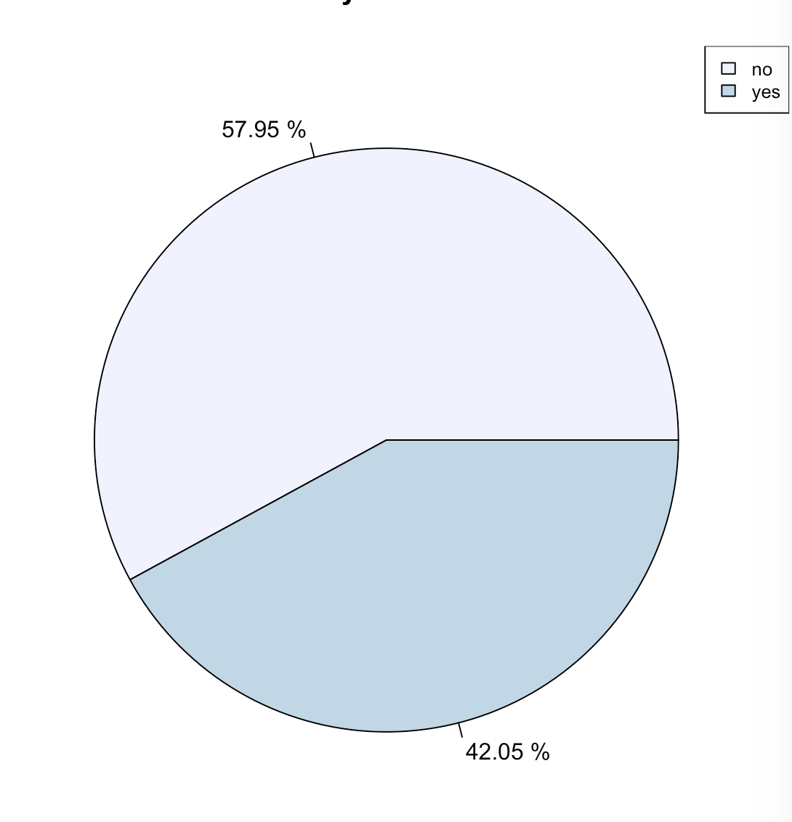
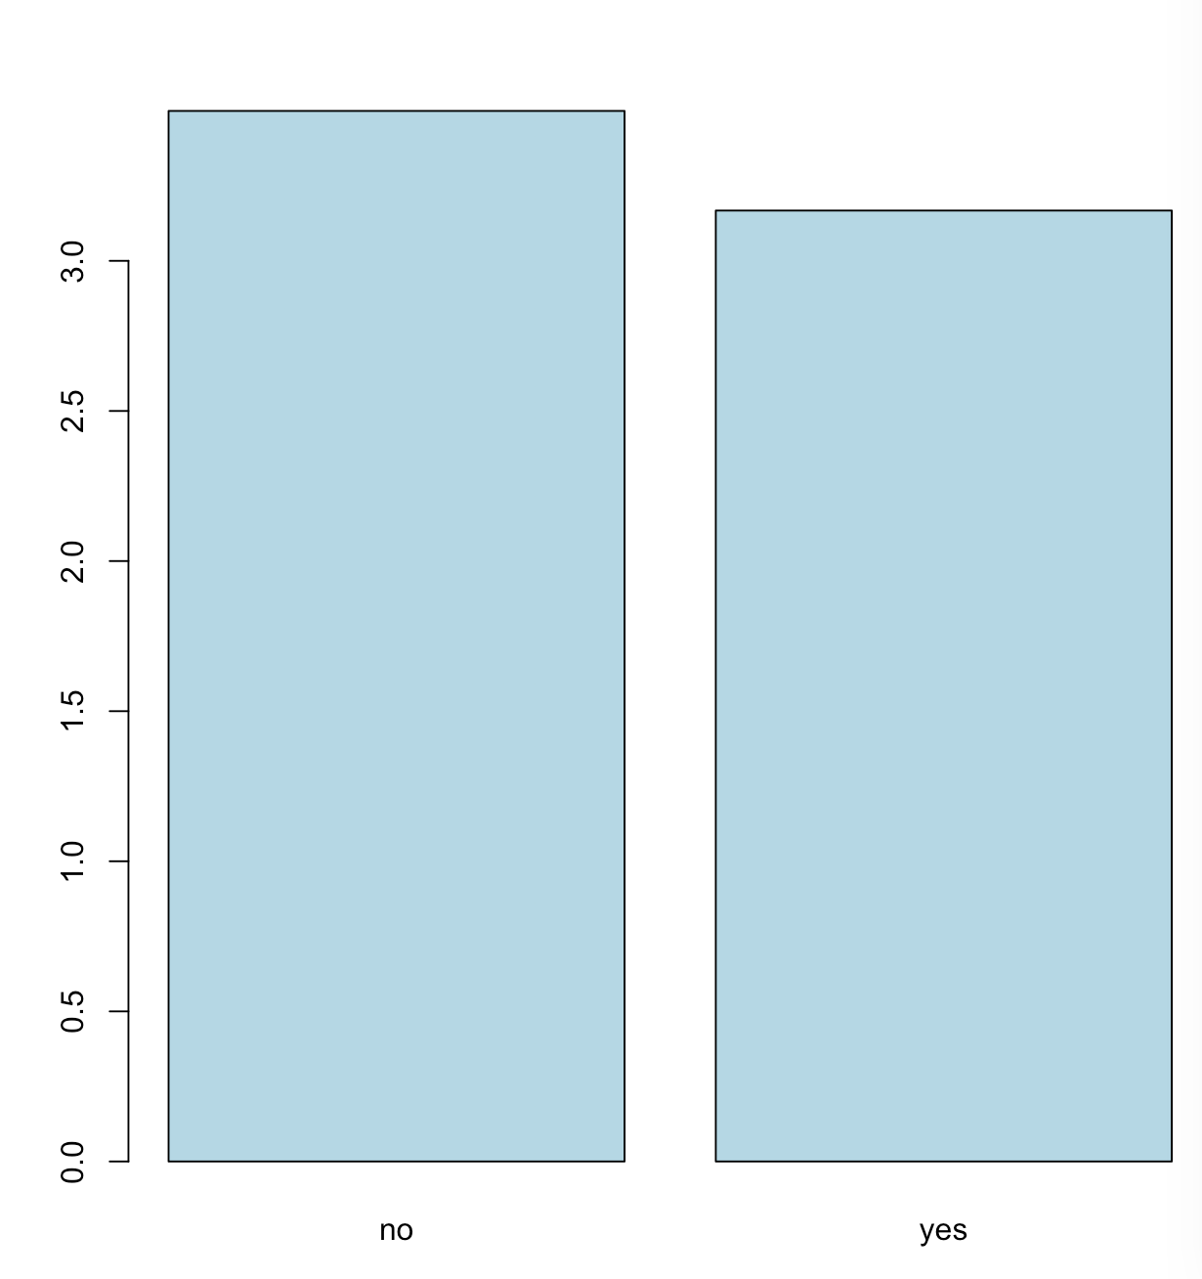
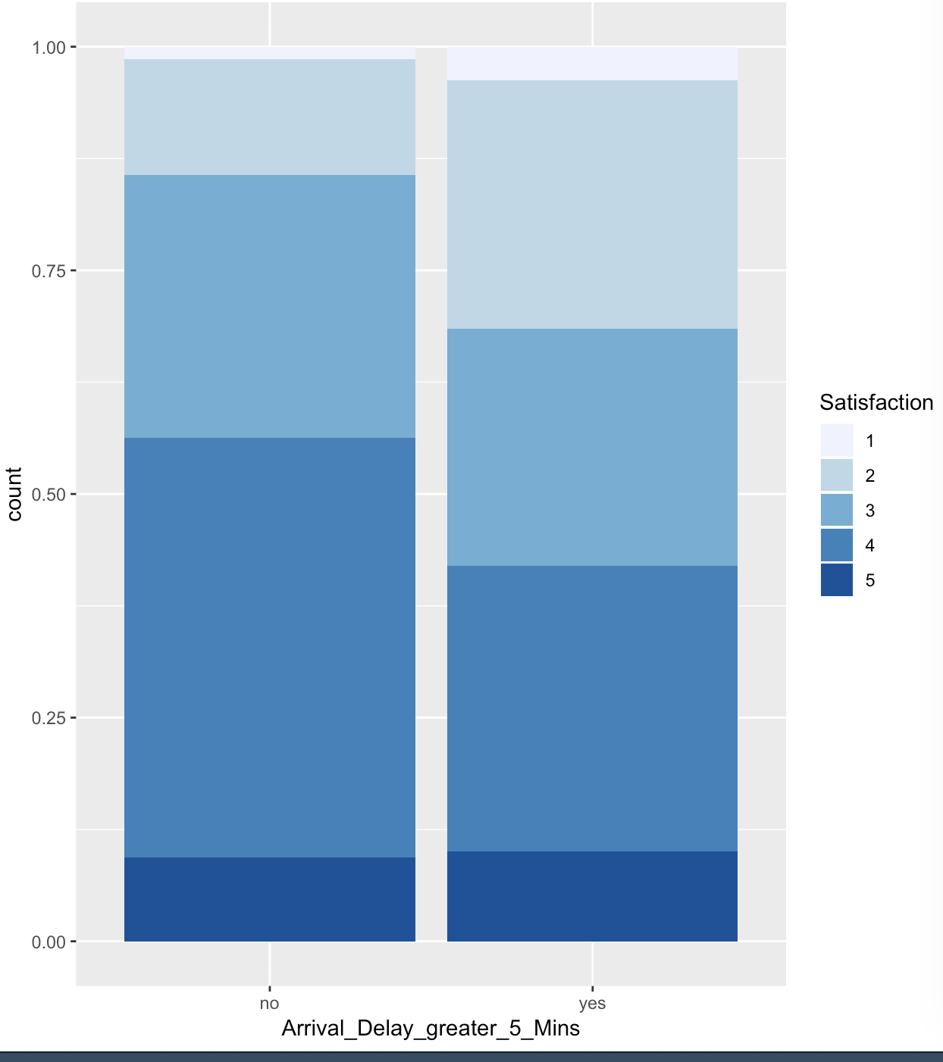
Flight delay greater than 5 minutes
Proportion of satisfaction rate
Average satisfaction
Over 55% of our flight are not delayed more than 5 minutes.
Customers with flight delay greater than five minutes would give lower score of satisfaction.

Slide 14
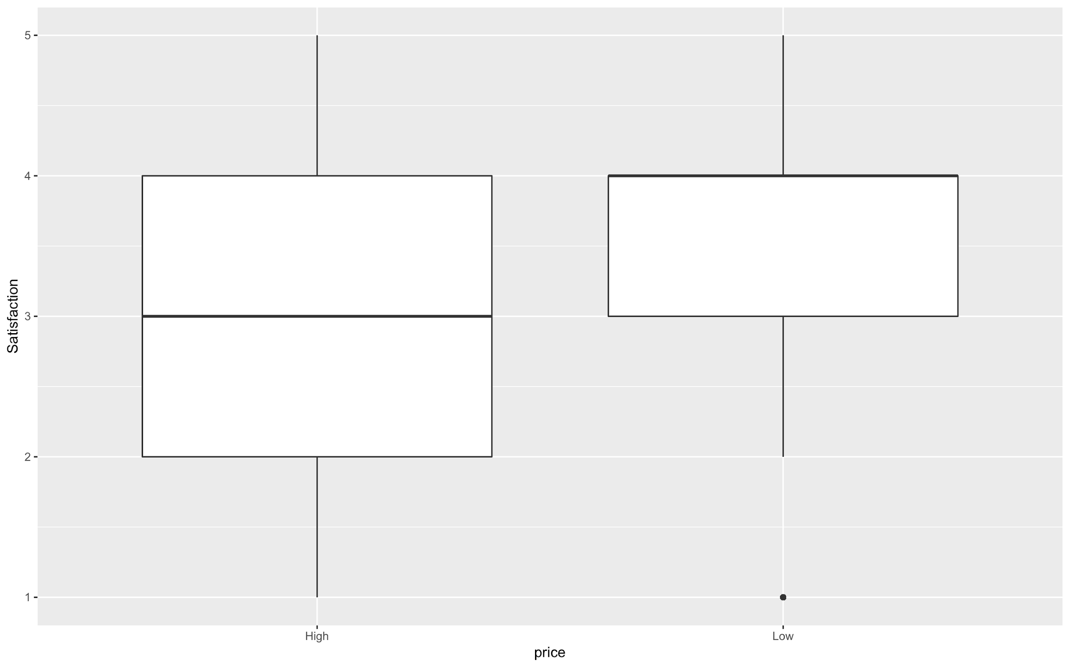
Cheapseats Airline Customers’ Price sensitivity
Customers with low price sensitivity prefer to give higher score for satisfaction.

Slide 15
Modeling Analysis: Linear Model
The linear model portrayed the dependency of the customer satisfaction on variables:
Customers’ Age
Customers’ Gender
Customers; Travel type
Customers’ Ticket Class
Price Sensitivity
Number of flights taken by the Customer per year
Flights delayed more than 5 minutes
The strength of the relation between Customer Satisfaction and the combination of above variables is around 45%

Slide 16
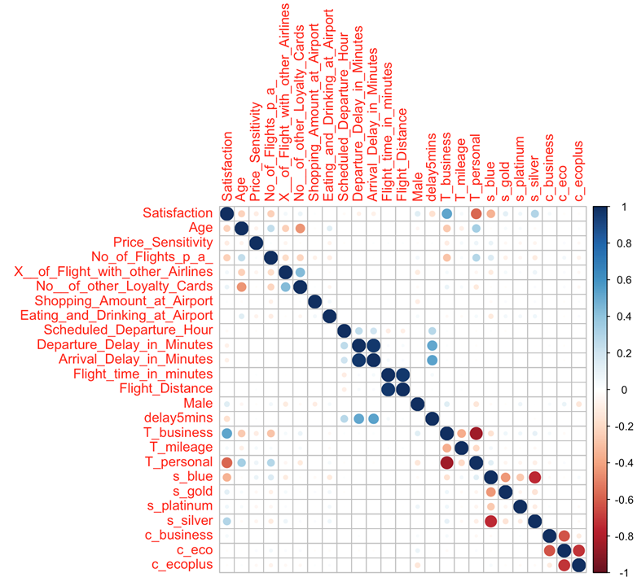

Slide 17
Modeling Analysis: Association Rule Mining
High satisfied Customer Attributes:
Adult Customers (Age 18-65)
Business Travel type
More number of Loyalty Cards (>2)
Delay less than 5 mins
Low Price Sensitivity
Low satisfied Customer Attributes:
Children and Senior Customer
Personal Travel type
Customer with no loyalty cards
More flights over the year
Female Customers
Economy Class Customers
Blue status Customer

Slide 18
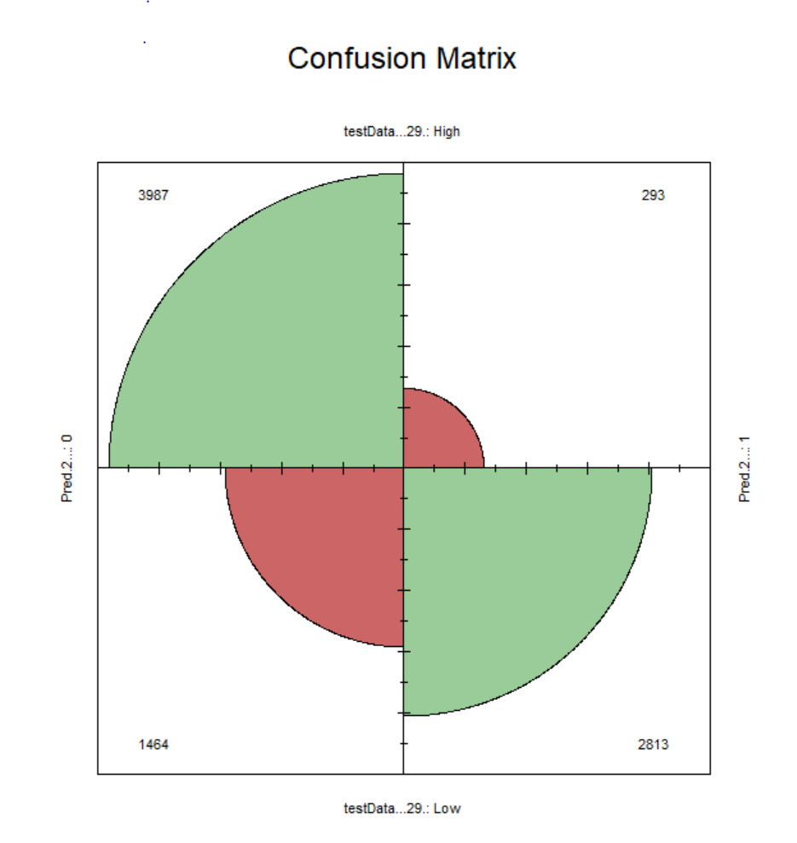
Model Testing: Support Vector Machines (SVM)
The model predicts the likelihood to recommend about customer’s Rating : Happy or Unhappy
The figure represents the number of times the model algorithm predicted customer satisfaction rating accurately
Accuracy Rate: 79.5 %
Model was based on Age, Airline Status, Type of Travel, Number of Flights, Gender, Delay greater than 5 minutes, Class and Price Sensitivity

Slide 19
Recommendations
Customers travelling for personal travel should be provide better in-flight services
Better in-flight services like goodies and kids based entertainment services to children. Extended escort services and faster gate access to senior citizens
Provision of better offers and opportunities to Blue customers for them to upgrade to higher status like Silver status
Co-passenger preference to female customers travelling alone
Provision of more loyalty cards to the frequent flyers
Provision of promotional loyalty cards and occasional free upgrades to customers on economy class
Provision of free lounge access and stay over facilities to the customers with delayed flights

Slide 20
THANK YOU!

